Slide 1

Multivariate Power comparisons
Ben Rohlfing

Slide 2
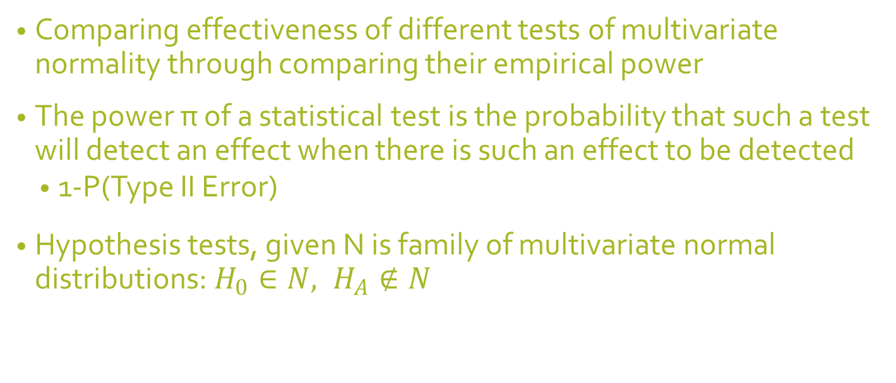
Purpose
Comparing effectiveness of different tests of multivariate normality through comparing their empirical power
The power π of a statistical test is the probability that such a test will detect an effect when there is such an effect to be detected
1-P(Type II Error)
Hypothesis tests, given N is family of multivariate normal distributions:$H_{0}∈N, H_{A}∉N$

Slide 3
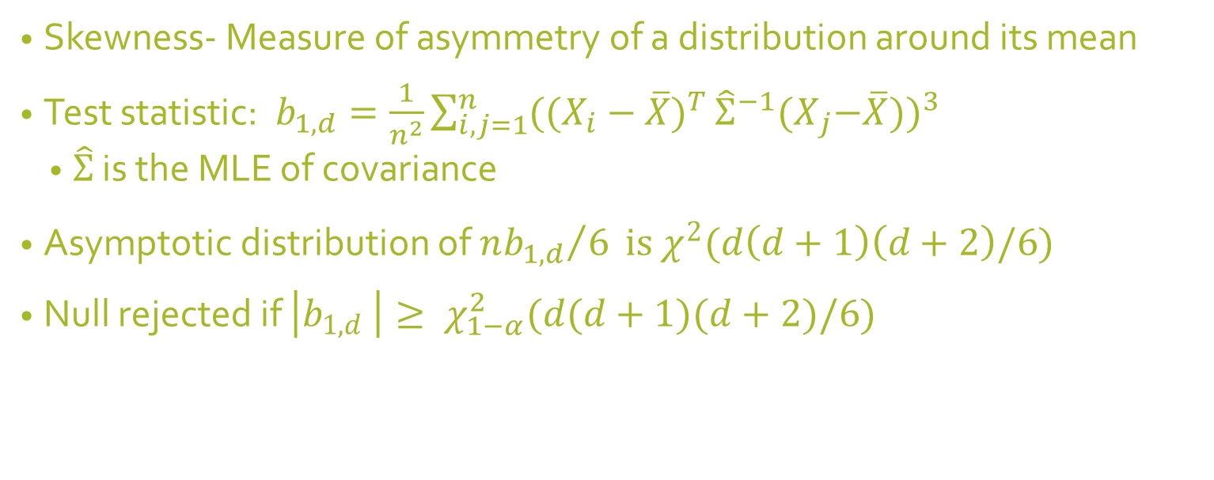
Mardia’s multivariate skewness
Skewness- Measure of asymmetry of a distribution around its mean
Test statistic: $b_{1,d}=\frac{1}{n^{2}}{\sum_{i,j=1}^{n}{({(X_{i}−\overline{X})}^{T}}{\hat{Σ}}^{−1}{(X}_{j}−\overline{X}))}^{3}$
$\hat{Σ}$ is the MLE of covariance
Asymptotic distribution of ${nb_{1,d}}/6 is χ^{2}(d\left(d+1\right)\left(d+2\right)/6)$
Null rejected if $\left|b_{1,d} \right|≥ χ_{1−α}^{2}(d(d+1)(d+2)/6)$

Slide 4
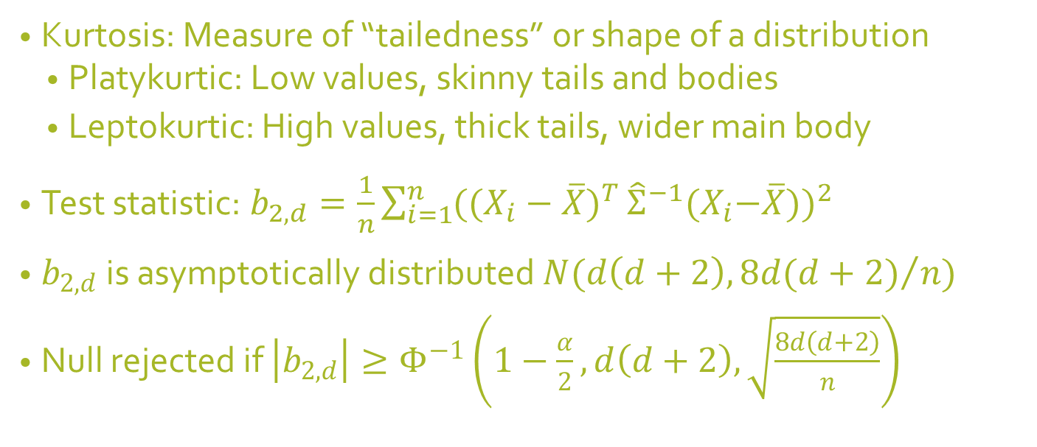
Mardia’s multivariate kurtosis
Kurtosis: Measure of “tailedness” or shape of a distribution
Platykurtic: Low values, skinny tails and bodies
Leptokurtic: High values, thick tails, wider main body
Test statistic: $b_{2,d}=\frac{1}{n}{\sum_{i=1}^{n}{({(X_{i}−\overline{X})}^{T}}{\hat{Σ}}^{−1}{(X}_{i}−\overline{X}))}^{2}$
$b_{2,d}$ is asymptotically distributed $N(d\left(d+2\right), {8d(d+2)}/{n)}$
Null rejected if $\left|b_{2,d}\right|≥Φ^{−1}\left(1−\frac{α}{2}, d\left(d+2\right),\sqrt{\frac{8d\left(d+2\right)}{n}}\right)$

Slide 5
Shapiro-Wilk test
Based on regression of sample order statistics on their expected values under normality
Critical values approximated from a normal transformation of the test statistic

Slide 6
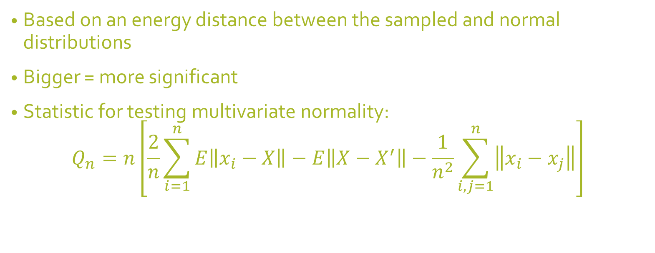
Energy test
Based on an energy distance between the sampled and normal distributions
Bigger = more significant
Statistic for testing multivariate normality:
$$Q_{n}=n\left[\frac{2}{n}\sum_{i=1}^{n}{E\left\|x_{i}−X\right\|}−E\left\|X−X^{′}\right\|−\frac{1}{n^{2}}\sum_{i,j=1}^{n}{\left\|x_{i}−x_{j}\right\|}\right]$$

Slide 7
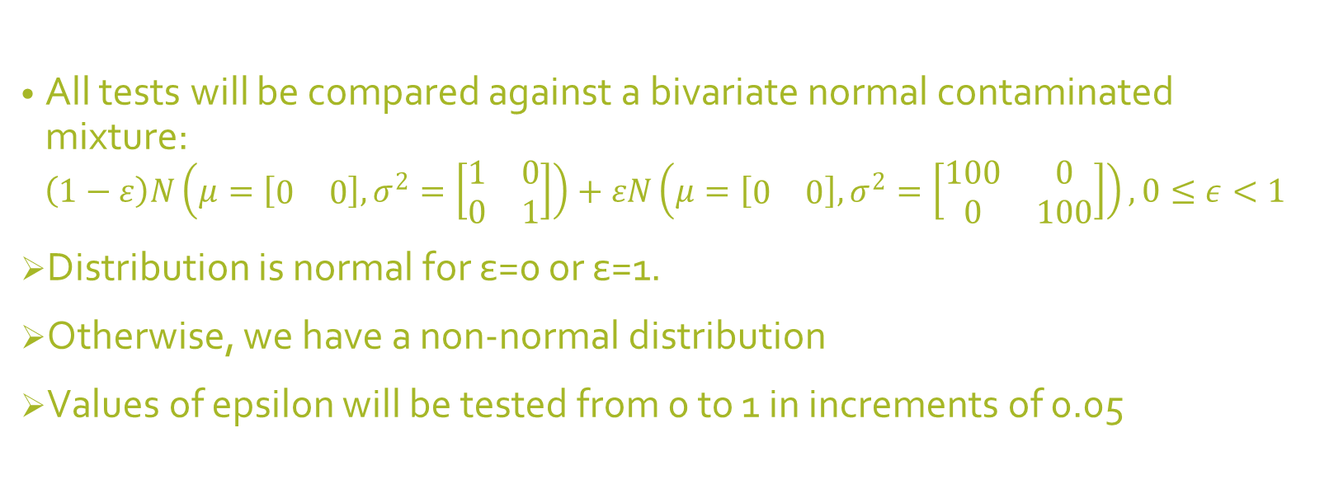
Test distribution
All tests will be compared against a bivariate normal contaminated mixture:
$$\left(1−ε\right)N\left(μ=\left[\begin{matrix}0 & 0\end{matrix}\right], σ^{2}=\left[\begin{matrix}1 & 0 \\ 0 & 1\end{matrix}\right]\right)+εN\left(μ=\left[\begin{matrix}0 & 0\end{matrix}\right],σ^{2}=\left[\begin{matrix}100 & 0 \\ 0 & 100\end{matrix}\right]\right),0≤ε<1$$
Distribution is normal for ε=0 or ε=1.
Otherwise, we have a non-normal distribution
Values of epsilon will be tested from 0 to 1 in increments of 0.05

Slide 8
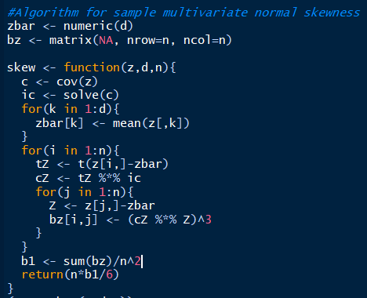
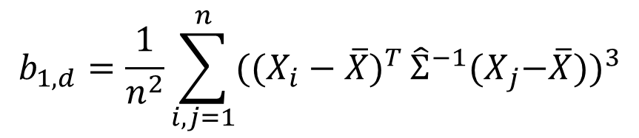
Multivariate skewness algorithm
$$b_{1,d}=\frac{1}{n^{2}}{\sum_{i,j=1}^{n}{({(X_{i}−\overline{X})}^{T}}{\hat{Σ}}^{−1}{(X}_{j}−\overline{X}))}^{3}$$

Slide 9
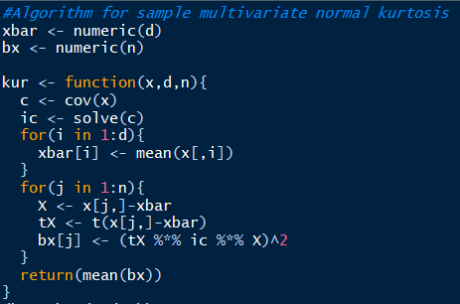
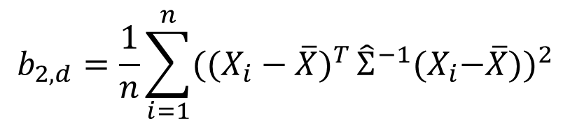
Multivariate kurtosis statistic
$$b_{2,d}=\frac{1}{n}{\sum_{i=1}^{n}{({(X_{i}−\overline{X})}^{T}}{\hat{Σ}}^{−1}{(X}_{i}−\overline{X}))}^{2}$$

Slide 10
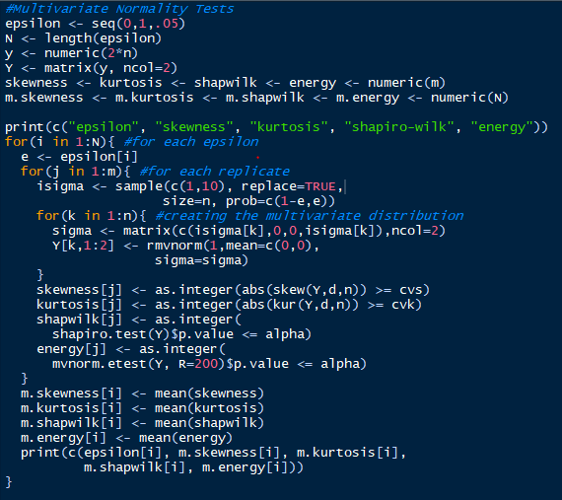
Simulation Algorithm

Slide 11
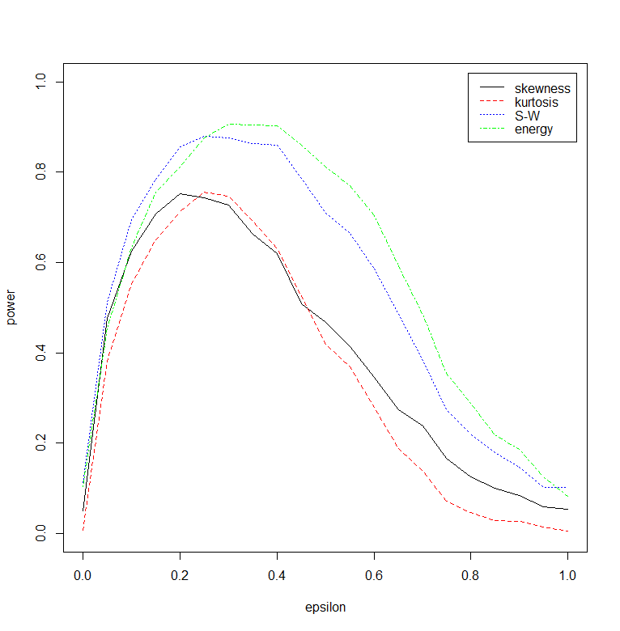
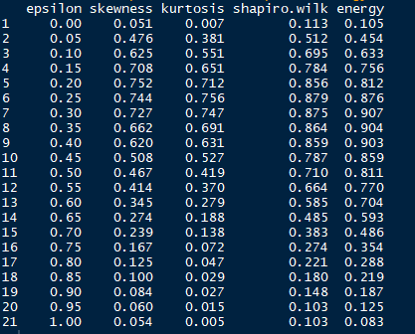
Results
n=30, m=1000, alpha=0.1, d=2

Slide 12
Conclusions
Energy test is most powerful test in terms of power, or detecting non-normality when there is non-normality to be detected
Second most powerful: Shapiro-Wilk test
Third most powerful: Mardia’s skewness test
Least powerful: Mardia’s kurtosis test

Slide 13
Limitations
Inefficient algorithm: Takes at least 5-10 minutes to run the algorithm with n=30 samples and m=1000 replicates
One possibility: Data points for each bivariate distribution are generated one at a time
Only a handful of normality tests carried out
Only tested against one distribution

Slide 14
References
Bibliography
Rizzo, M. L. (2019). Statistical Computing with R, Second Edition. CRC Press.

